Slide 1
Notes:
Ladies and Gentlemen,
Good Morning.
Introduce myself

Slide 2
Infectious Diseases Risk Assessment in Qatar
Notes:
I am here today to give this brief talk, titled “ Infectious diseases risk assessment in Qatar”
I will start with a short introduction of the Biomedical Research center.
followed by a discussion of the challenges facing Qatar and the gulf states in terms of biosecurity.
And where does the BRC come in

Slide 3
About the Biomedical Research Center - Qatar University
Established on September 2014
To Improve Qatar’s Health by Focusing on Research, Training and Services in Applied and Basic Research Fields
Notes:
Read the slide.

Slide 4
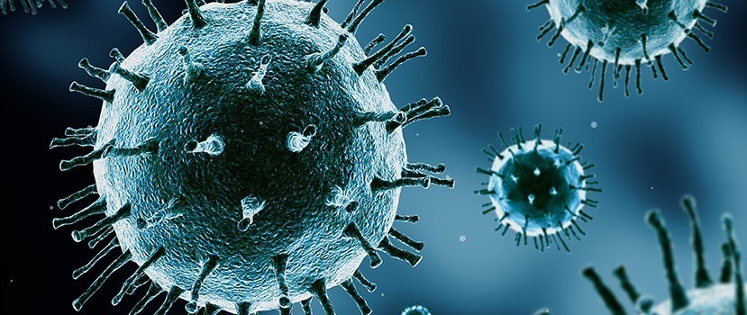
BRC Divisions
Infectious Diseases
Metabolic Disorders
Genomics
Notes:
The BRC has three division, infectious diseases, Metabolic disorders, and genomics.
I will focus on infectious diseases.

Slide 5
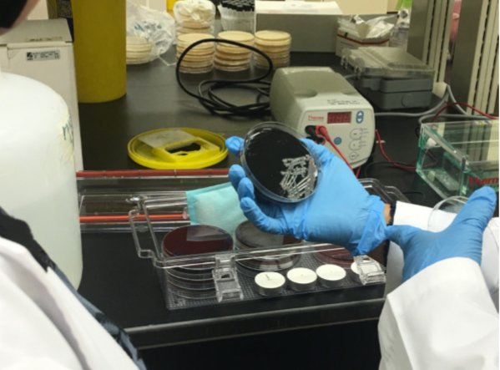
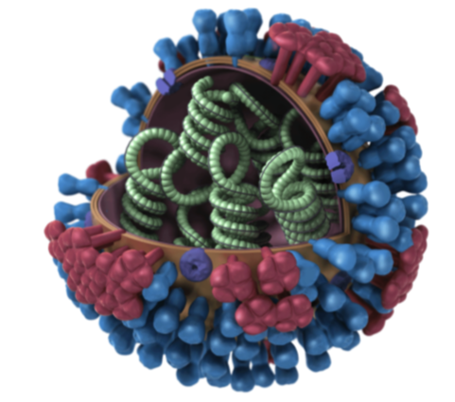
About the Infectious Diseases Division
Diverse and complementary experience in basic and translational research.
Develop innovative approaches.
Understanding, preventing, diagnosing and treating infectious diseases.
Notes:
The staff at the infectious diseases division, has diverse and complementary experience in basic and translational research.
Through their work, and collaborations, they aim to develop innovative approaches in the study of infectious disease.
To develop understanding, prevention, diagnosis, and treatment of infectious diseases.

Slide 6
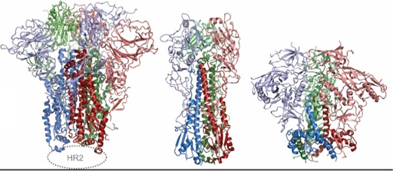
Research in Infectious Diseases
Antimicrobial resistance of bacteria in human, animals and the environment (One Health Approach).
Epidemiology of communicable diseases in Qatar.
Characterization of zoonotic infections.
Viral immunology.
Molecular microbiology.
Notes:
Read the slide.

Slide 7
Biosecurity Challenges to Qatar & Gulf States
Zoonoses
Diseases of animals (Food-security)
Bioterrorism
Notes:
The Gulf States, including Qatar, face several challenges with respect to preparedness for ‎emerging infectious ‎diseases threatening veterinary and human health.
These can be broadly categorized into:

Slide 8
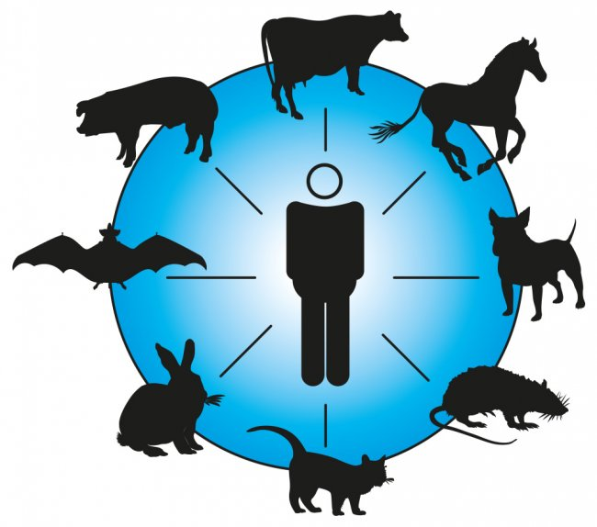
Biosecurity Challenges to Qatar & Gulf States: Zoonosis
Zoonosis: a disease that can be transmitted from animals to humans.
MERS-CoV continues to pose a threat to the public health as the virus circulate in Camels.
Various zoonotic infections have been reported in the region.
Including: Rabies, Alkhurma Hemorrhagic Fever Virus, Dengue Fever, Crimean-Congo hemorrhagic fever, Rift Valley Fever, and many others.
Qatar has a heavy ‎influx of foreign labor:
‎‎94% of the total labor force.
Originating from countries endemic for zoonoses.
Notes:
The firs challenge, Zoonosis, is a term that refers to disease that can be transmitted from animals to humans.
For example, MERS-CoV continues to pose a threat to the public health as it is circulating in camels.
Various others have been reported in the region.
which could be a serious problem in mass-gathering events.
Heavy influx of labor
This increases risks for introduction of new pathogens into the country. ‎

Slide 9
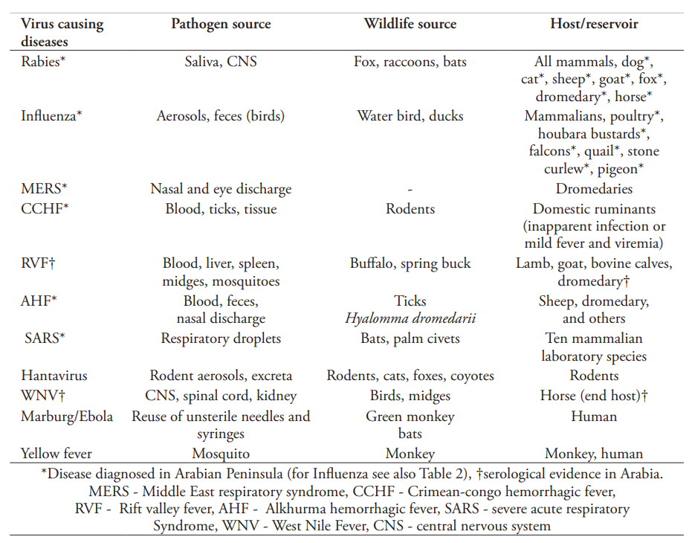
Biosecurity Challenges in Qatar & Gulf States: Zoonosis
Important zoonotic viral diseases
Zoonoses in the Arabian Peninsula; Ulrich Wernery; Saudi Med J 2014; Vol. 35 (12)
Notes:
In 2014, a team of scientists investigated various zoonotic viruses in the arabian peninsula.
They found evidence of several viruses circulating in the population. This evidence is either infected patients, or serological evidence in the form of antibodies.
Rabies, influenza, MERS, RVF, WNF, AHF,

Slide 10
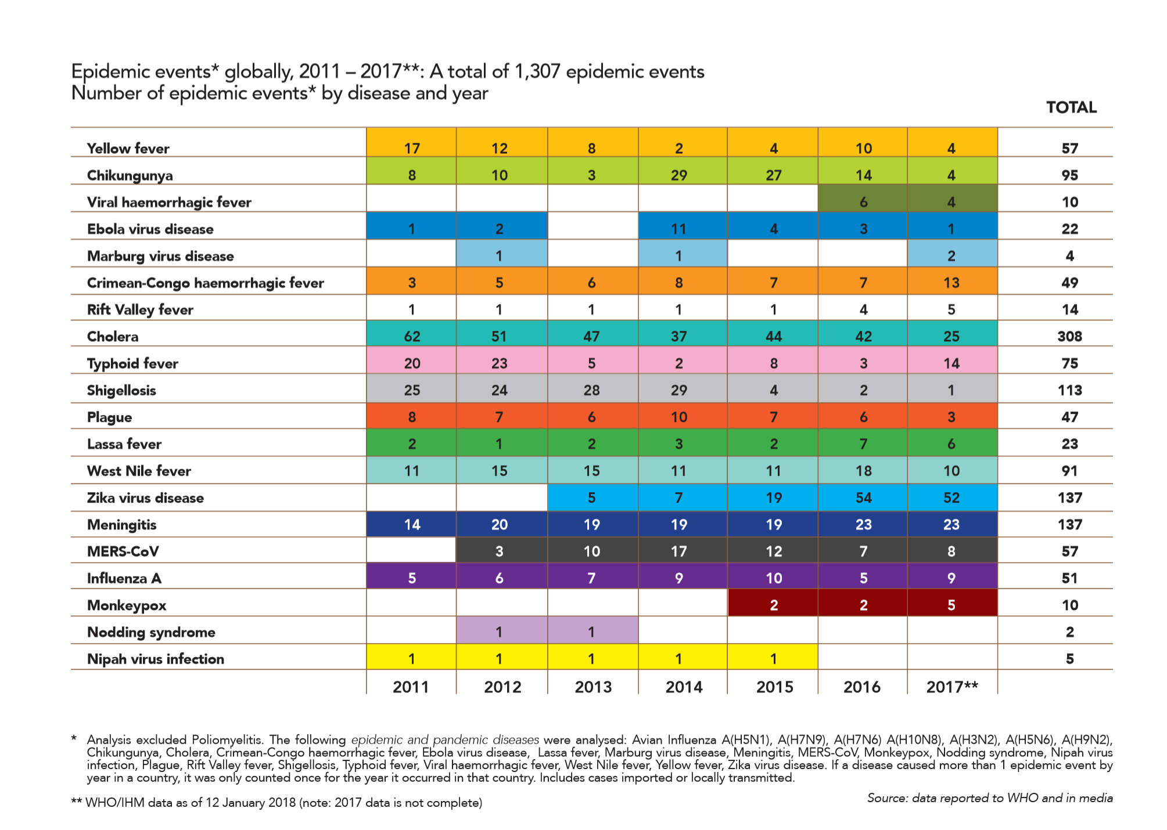
Recent Outbreaks
Notes:
In fact, zoonoses remains a challenge even at a global scale.
This table shows data from the WHO detailing epidemic over the period from 2011-2017.
1307 epidemics.
Some of which are zoonotic disease that have been reported in the region.

Slide 11
Biosecurity Challenges in Qatar:
Food Security
As Qatar continues to grow its population of food-producing animals to reach self-sustenance, there is risk of introducing new pathogens to the nation along with imported animals.
Notes:
The second challenge,is food security.
As Qatar is moving towards self-sustenance, the population of food-producing animals is increasing.
This increases the risk of introducing new pathogens with the imports.
We need to be able to test and identify rapidly.

Slide 12
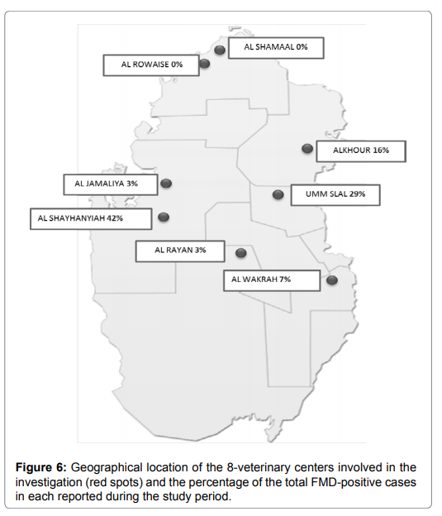
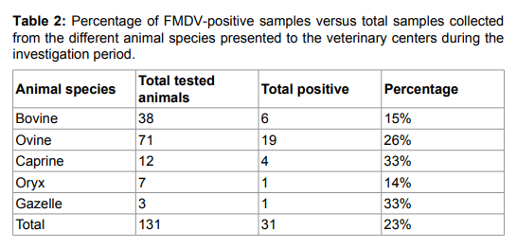
Livestock movement: Food Security and Zoonosis Issues
Identification of Foot and Mouth Disease Virus Strains Originating from Multispecies Susceptible Animals. Abdulla NM, Mohran KA, Haroun M, Ausama AA, Shalaby MA.
J Vet Sci Med Diagn 2017, 6:1.
Notes:
In 2016, a study was conducted to identify strains of the FMDV in animals in the country.
Using molecular tests.
15% of cows.
23% total

Slide 13
Other Potential Biothreats
Mail remains the number one method for bioterrorism attacks.
Illustrated by: the 2001 ‎Anthrax attacks, and the recent ricin threats to the White House.‎
Qatar continues to develop and incorporate new services to maintain high living ‎standards for its residents.
Monitoring biothreats using cutting edge technologies for identiﬁcation and assessment of risk factors is essential.
Notes:
As for bioterrorism, postal mail has been and remains the number one method.
As Qatar continues to expand and develop…
So, what can we do about it?

Slide 14
Preventing / Combatting an Outbreak
Active-surveillance
Rapid identification
Rapid response
Exchange of information
Notes:
Prevention of outbreaks is dependant on:
Active surveillance.
Astute and vigilant personell.
It’s difficult to predict what outbreak will occur and where it will come from.
Rapid Identification.
Rapid response.
Exchange of information.

Slide 15
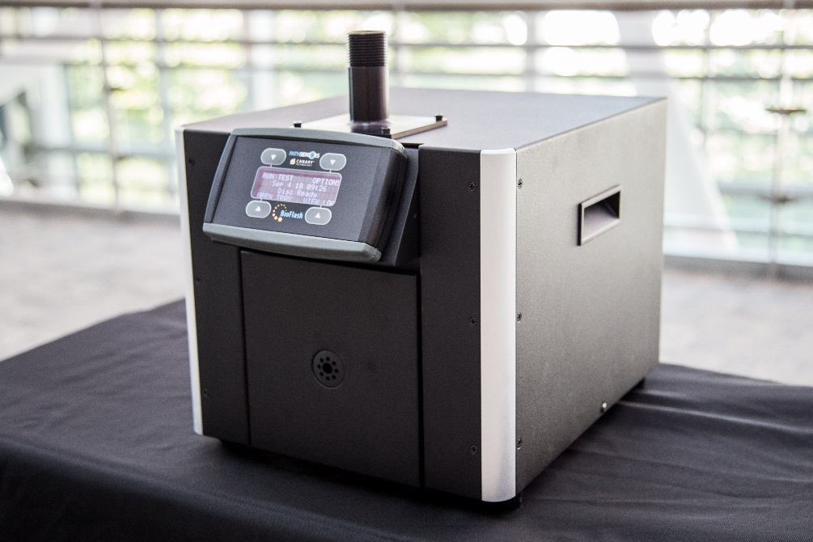
Rapid Identification of Biothreat Agents
Low-risk and cost-effective.
Low maintenance.
Military force protection.
Facility security monitoring (Mail offices, Metro, etc.).
Biological identifier for highly dangerous reagents:
Anthrax (Bacillus anthracis)
Black Plague
Botulism
Ricin
Smallpox
Tuleremia
BioFlash® Biological Identifier
Notes:
solution to biological sampling and identification
Balanced design to survive today’s toughest environments

Slide 16
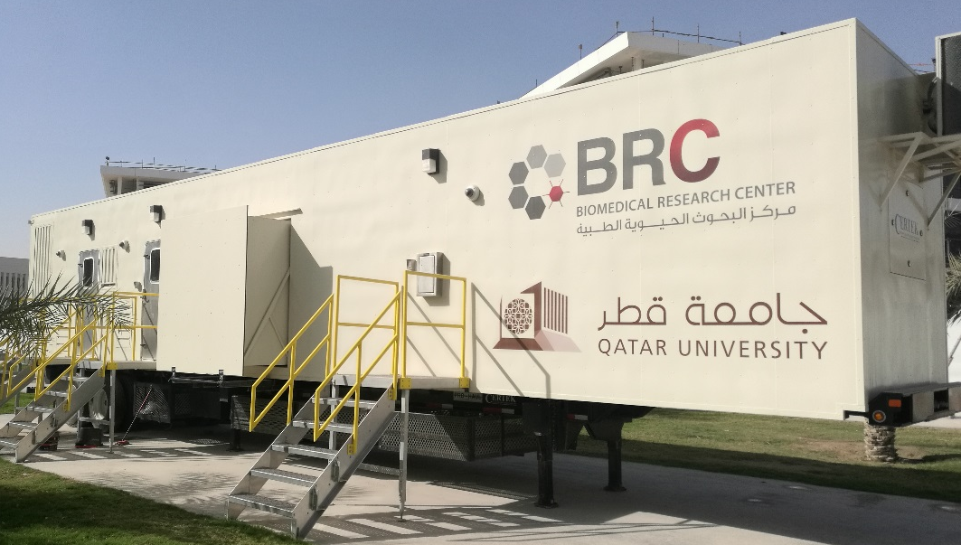
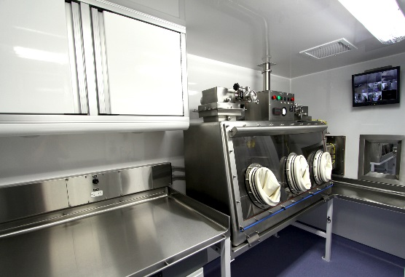
First BSL3 Facility for Research in Qatar
First facility of its kind in Qatar for research and diagnostic purposes.
Mobile facility: can be transferred anywhere in the nation in case of outbreaks.
Enables the handling of highly infectious and pathogenic organisms: Influenza H5N1, MERS-CoV, Brucella, and others.
Notes:
This allows for the rapid response, as the facility can go directly to the site.
Making testing much faster, and subsequent isolation and control of the spread much quicker.
China employed a mobile BSL-3 facility suring the Ebola outbreak in 2014 in Sierra-Leone.
However, even with all the instrumentation and facilities, it is not enough.
The process needs to be highly coordinated between all involved entities.
The capabilities must be built.

Slide 17
Preventing / Combatting an Outbreak
Keystones to success:
Teamwork and collaboration.
Effective communication.
Building the knowledge base and capabilities.

Slide 18
Final Remark
“to make the world safer, global health security depends crucially on much greater awareness, cooperation and collaboration between individual countries, agencies, organizations and communities”
-Managing Epidemics: Key facts about major deadly diseases Handbook (WHO; 2018)
Thank you

